Slide 1
Object detection robot
By: Vivek Ponnala

Slide 2
Index
Introduction
Literature survey
Theoretical Analysis
Software design
Experimental investigations
Flowchart
Result
Advantages and Disadvantages
Applications
Conclusion
Future Scope
Bibliography
Robot output screenshot

Slide 3
Introduction
Object detection is the main ability for robots to interact with an environment and perform tasks correctly.
Objects can be detected from raw image data with the YOLO object detection model

Slide 4
Literature Survey
There may not be enough data points for the object data type.
Objects can appear drastically different from different viewing angles
The proposed solution is to develop a robot application in the simulation world integrated with vision and object detection capabilities.

Slide 5
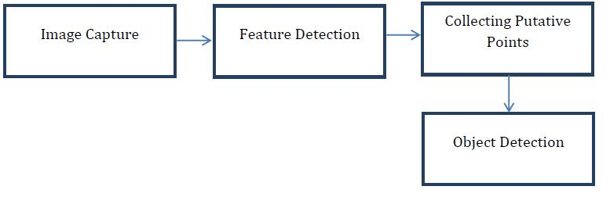
Theoretical Analysis

Slide 6
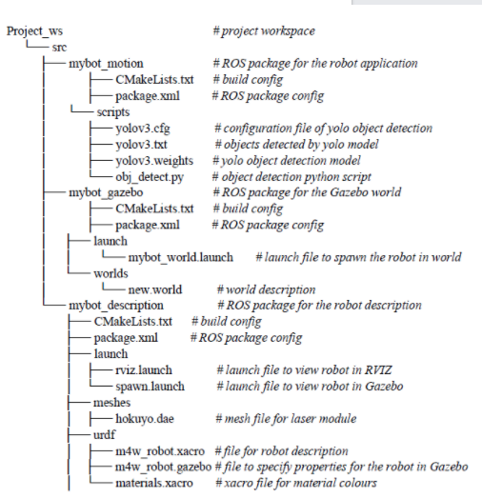
Hardware/software designing

Slide 7
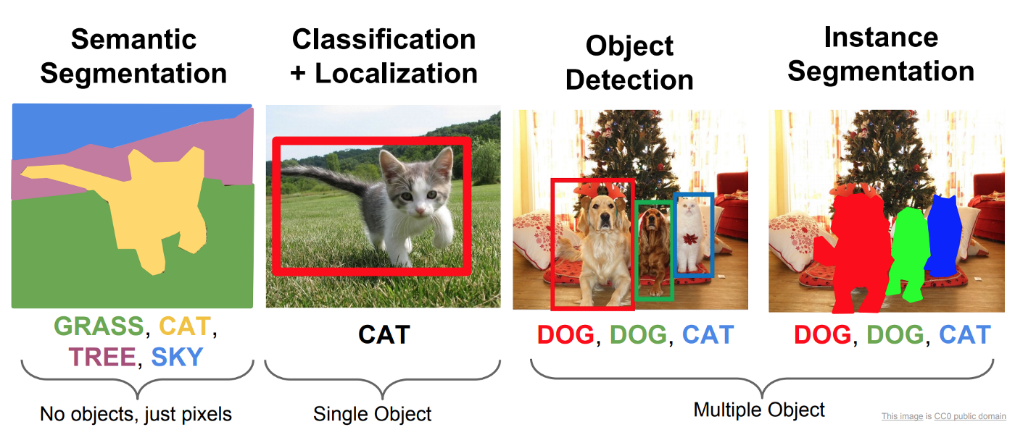
Experimental Investigations

Slide 8
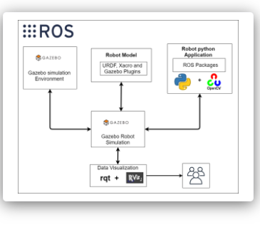
Flowchart

Slide 9
Result
Gazebo simulator loads with cone, stop sign, traffic lights, car, fire hose and person
With raw_image/camera topic rqt shows cone, stop sign, traffic lights, car, fire hose and person
After running obj_detect.py, objects are successfully detected

Slide 10
Advantages and disadvantages
Real-time detection
Simple network structure
Low detection precision
Locate objects with horizontal bounding box
Poor results for small and dense objects
Easy to mislocate

Slide 11
Applications
Picture Retrieval
Security
Observation
Computerized vehicle systems
Machine investigations

Slide 12
Conclusion
Object detection is a key ability for most computer and robot vision systems.

Slide 13
Future Scope
Object detection will open up new avenues of research and operations that will reap additional benefits in the future.

Slide 14
Bibliography
https://smartinternz.com/Student/guided_project_info/5077#
https://www.ijcai.org/Proceedings/11/Papers/346.pdf
https://www.researchgate.net/figure/Block-Diagram-for-Object-Detection_fig1_3107699
42
https://www.researchgate.net/figure/The-advantages-and-disadvantages-of-existing-obj
ect-detection-methods_tbl1_338847053
https://www.pixelsolutionz.com/application-object-detection-real-life/
https://blog.rebellionresearch.com/blog/the-future-of-object-detection

Slide 15
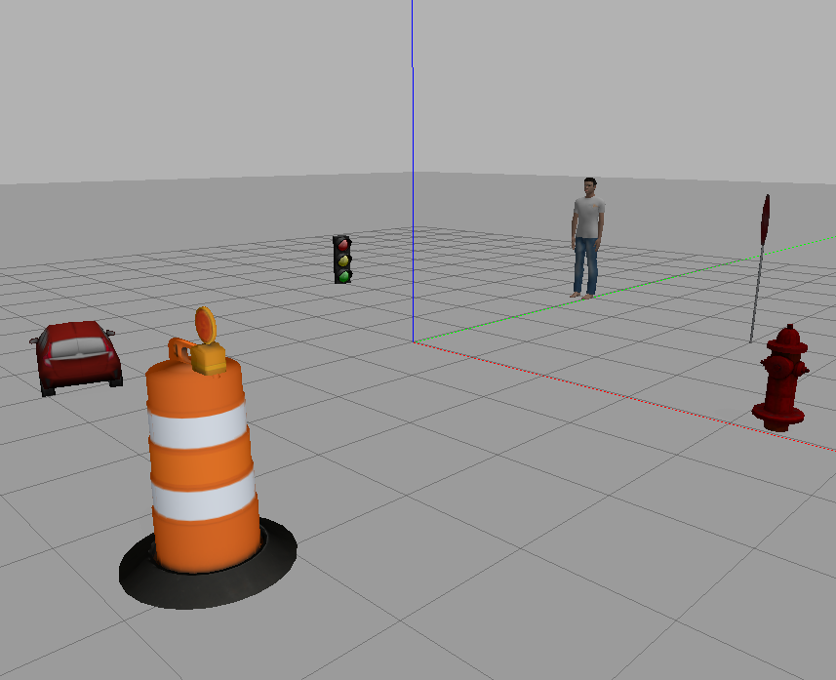


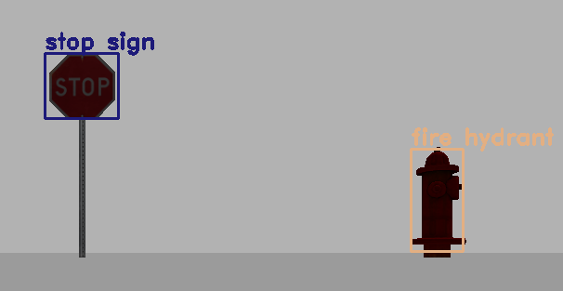
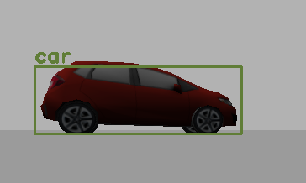
Appendix

